Slide 1
Cardiorespiratory Endurance Fitness
Objectives:
Students will understand the principle of cardiorespiratory endurance fitness (CR) and the components of CR fitness i.e. (a) Overloading & the Muscle pump (b) aerobic exercises (c) training heart rate (d) FITT safety: frequency, intensity, time, type (e) reduced health risks
Participate in a 1.5 mile run
Indian Hills Middle School

Slide 2
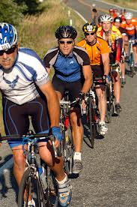
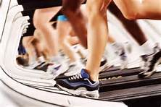
Cardiorespiratory Endurance:
Refers to the basic working efficiency of the heart, lungs and vascular system---your pump and your pipes.

Slide 3
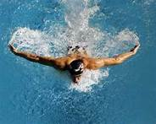
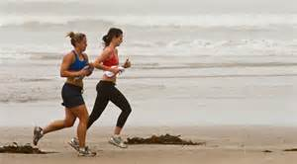
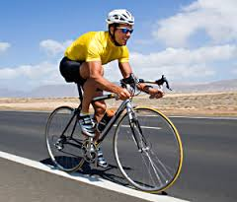
Overloading & the Muscle Pump:
Activities that improve cardiorespiratory endurance use the large muscles in the legs and squeeze a greater volume of blood into the heart chambers. This increases cardiac output called OVERLOADING. Eventually, this will decrease the amount of work for the heart at rest by pumping more blood volume with less beats per minute.
Jogging, swimming, stair stepping, bicycling, aerobic dance

Slide 4
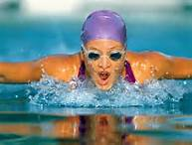
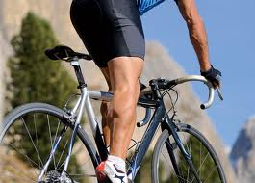
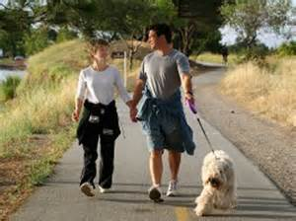
Aerobic Exercise:
Aerobic Activities
Large amounts of oxygen exchange take place.
Increases the fitness levels of cardiorespiratory endurance.
Is rhythmic, continuous, and is sustained for longer periods of time, 15 minutes minimal to 30 minutes or more.
Jogging, swimming, bicycling, rowing, skating, cross-country skiing, walking…

Slide 5
F.I.T.T. Safety
F: Frequency
Frequency: how often?
3-5 days is best to maintain fitness and improve upon cardiorespiratory fitness
Exercising less than 3 times a week will not maintain an adequate level of fitness.

Slide 6
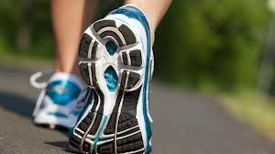
Intensity:
I: Intensity
How fast?
70-85% of your maximum heart rate
THR formula:220-age x 85%= THR
Your training heart rate should be between 150-185 beats per minute (12-14 year old)
Do not exceed your training HR for long periods of time as this could risk injury.
Monitor your heart rate at all times.

Slide 7
Polar Heart Rate Monitors
TriFIT Machine: measures and records fitness skills----
Daily work out routines
Pre & Post Fitness Assessments
1.5 mile run test
1.5 mile comparison
Polar Heart Training Monitors: Records heart rate and is downloaded on the TriFit machine.

Slide 8
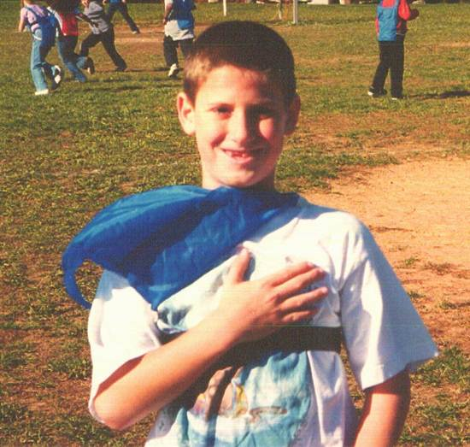
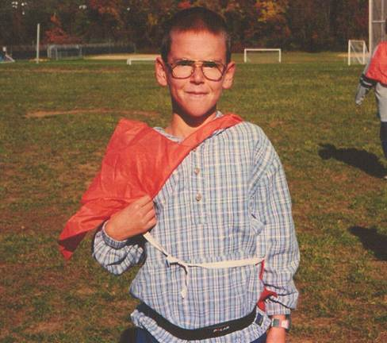
Using the Polar Heart Rate Monitors:
Trouble Shooting your download files:
High. Wear the transmitter just below the sternum and around the chest.
Tight. Keep the transmitter worn on the chest tight. You should not be able to pull the strap away from the chest.
Wet. Put water on the back of the transmitter.

Slide 9
Daily Workouts: downloaded &recorded on TriFit
This student worked in their training heart rate zone and some above: Excellent workout!

Slide 10
Example of a poor work out.
60% of the work out is under the 150 training heart rate zone.

Slide 11
Individual Workouts
Good Pacing Workout
Not Paying Attention Workout
This individual kept a good steady pace of around 178 beats per minute, resulting in an excellent workout.
This individual was not coded in properly and did not correct the problem, consequently the workout will result in poor performance.

Slide 12
Time or Duration:
T: Time, 15-30 minutes or more is a cardiovascular duration.
Cardiovascular Activities: jogging, bicycling,

Slide 13
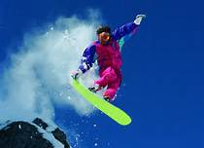
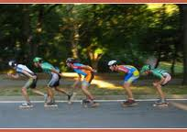
Type of Exercises:
T: type of exercises are aerobic in nature, use the leg muscles, and are rhythmic. Your exercise program should be centered around aerobic exercises.

Slide 14
Reduced Health Risks
If you follow these guidelines of FITT safety you will improve your cardiovascular health and reduce the onset of many risk factors for coronary heart diseases. Diseases such as high blood pressure, high cholesterol, obesity, sedentary living will all be reduced, enhancing your life and your tolerance of a stressful lifestyle will be improved.

Slide 15
Good Health Review & Questions
1.What is cardiorespiratory endurance?
2. Explain the muscle pump and the overload principle.
3. What is aerobic exercise?
4. Name an aerobic exercise.
5. Explain the F.I.T.T. principle as it applies to cardiorespiratory endurance.
6. List 3 things that would cause the heart monitors to fail.

